Slide 1
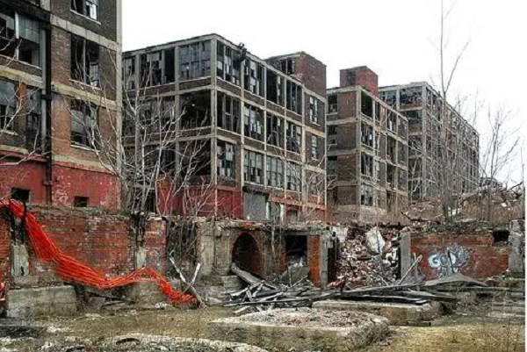
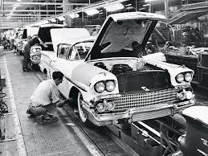
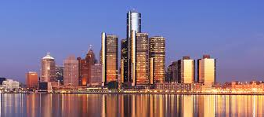
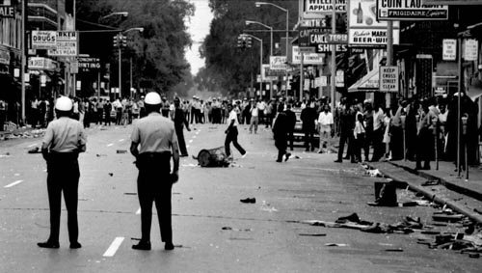
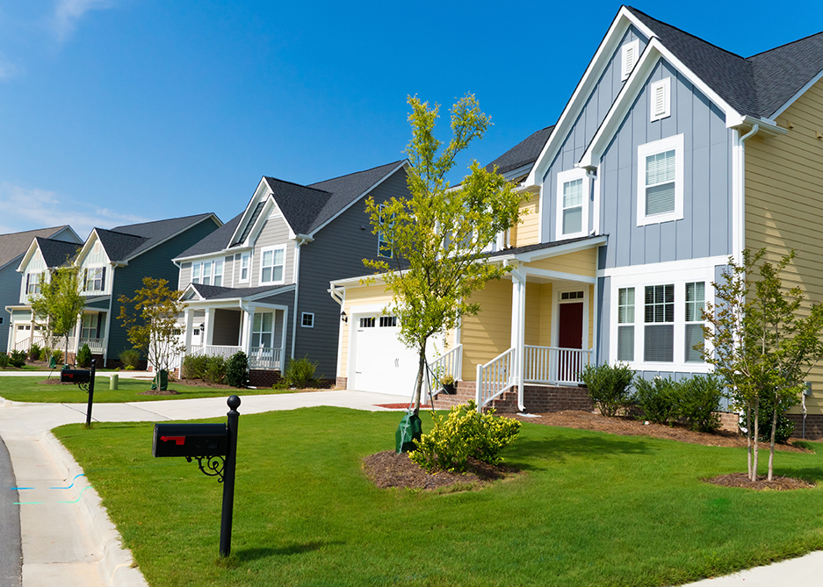
Income Inequality in Inner City Detroit
Eric Kim
Kenny Won
Lucy Wang

Slide 2
Eric

Slide 3
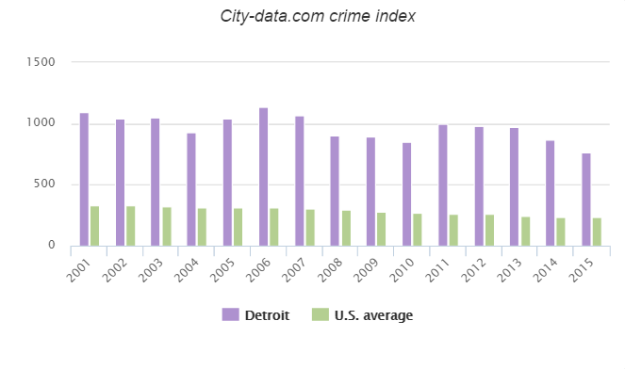
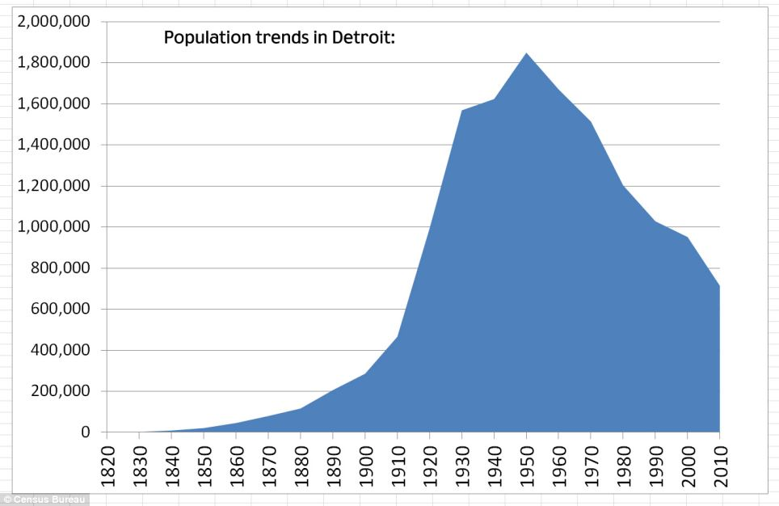
Current State of Detroit
Population Decrease: 1.85 million in 1950 to 670 thousand in 2016
Crime rates among the highest in the U.S.
Abandoned neighborhoods
Movements to revitalize the city

Slide 4
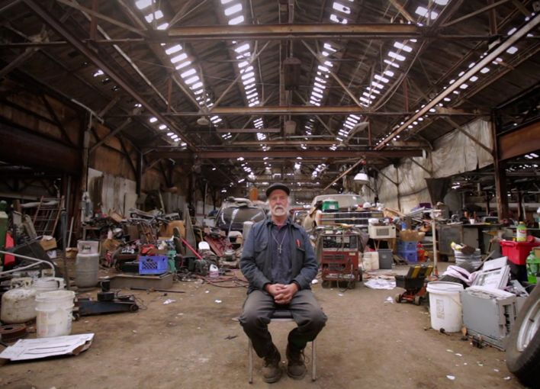
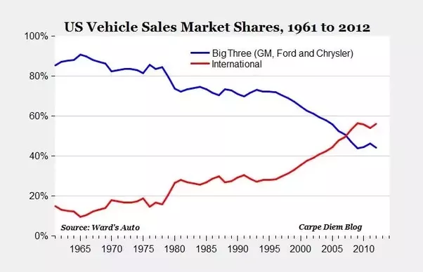
Decentralization of the Auto Industry
The Big Three (GM, Ford, Chrysler)
Plans to soften union power
Plants and suppliers move out of the city
Auto related businesses shut down

Slide 5
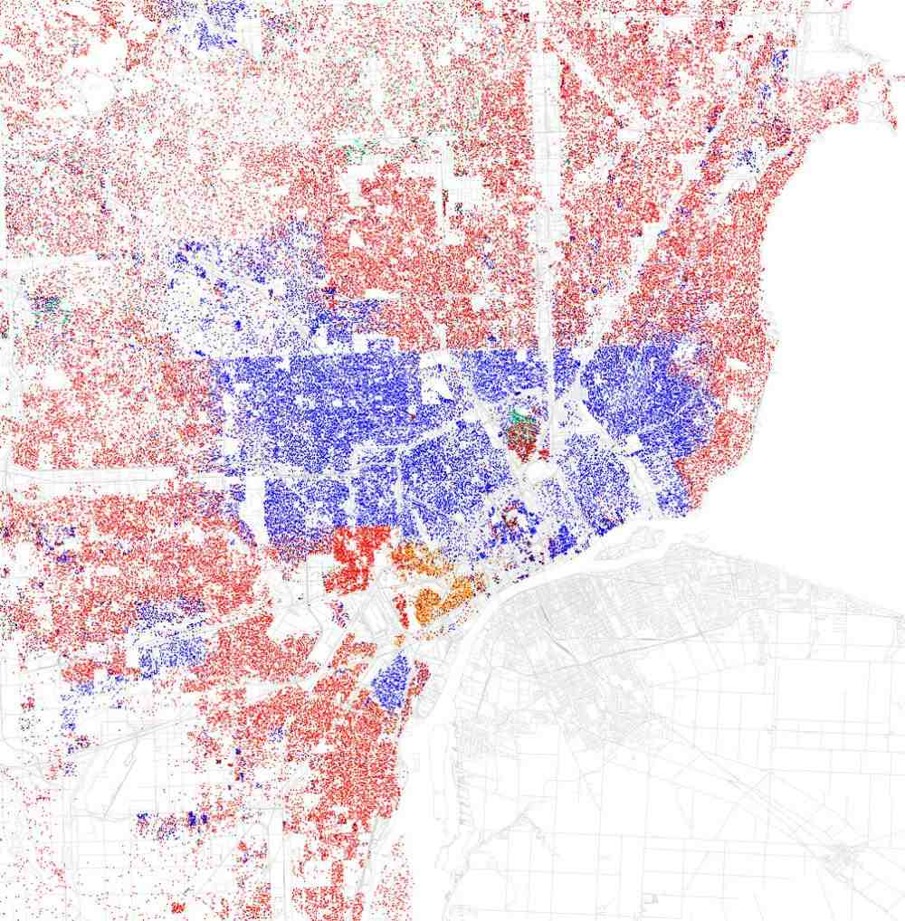
Racial Tensions
African American concentration in the inner city
White-collar workers in wealthy suburbs
Segregation of black and white community

Slide 6
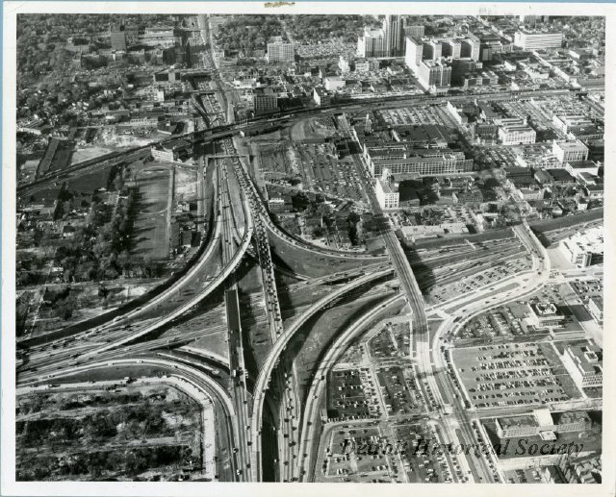
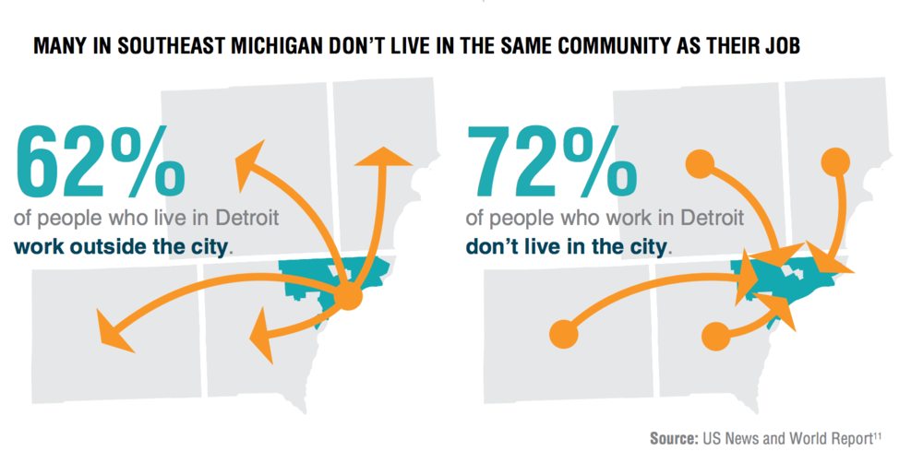
Transportation System
Public policies in favor of the auto industry
Construction of freeways
Destruction of African American communities
Difficulty in commuting to workplaces

Slide 7
Kenny

Slide 8
Business Propsal
Building low-cost housing for start-up company entrepreneurs

Slide 9
Lucy

Slide 10
Thank You
Eric Kim
Kenny Won
Lucy Wang

